Slide 1
Meeting with Oksana
13/03

Slide 2
Completed Tasks

Slide 3
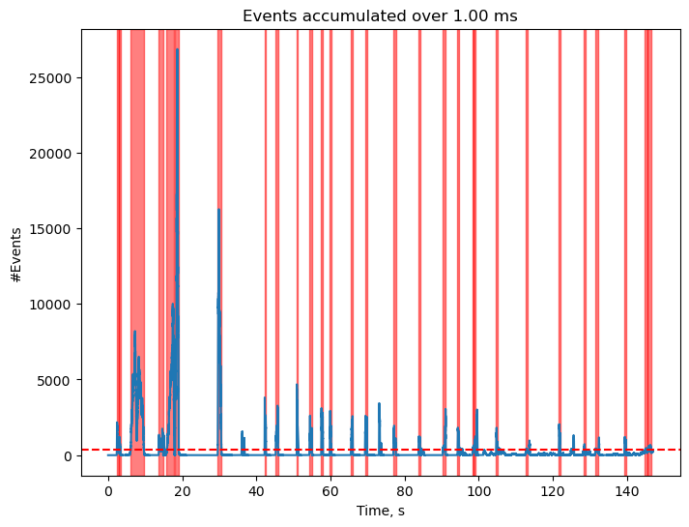
Develop Event Video Cropper

Slide 4

Developed Classical Ball Tracker
OpenCV HoughCircles
Kalman filter for continuity in s, r, ds, dr

Slide 5
Merged Tracking Results into a Dataset
Divided it into “Ball”, “Lemon”, “Background” and “All” versions
Still some cropped videos left to track

Slide 6
Ongoing and Proposed Future Tasks

Slide 7
Ongoing Tasks
SCNN implementation: The code throws no error, but it is very slow
Cuda is not working -> version mismatch

Slide 8
Proposed Future tasks
Explore dataset generation with IsaacSim
Heavy program, I’ll do this when I finish with the ongoing tasks.
Install a video-to-events simulator locally and integrate it into the pipeline

Slide 9
Future Tasks
Ball Tracker Network
Fix Cuda
Look into how the data is fed into the network. See how to implement time
Explore snn torch theory
Labelling
Check how I am generating the images. Binary result is not ideal for the labelling.
Logarithmic transformation to get better size labelling

